Slide 1
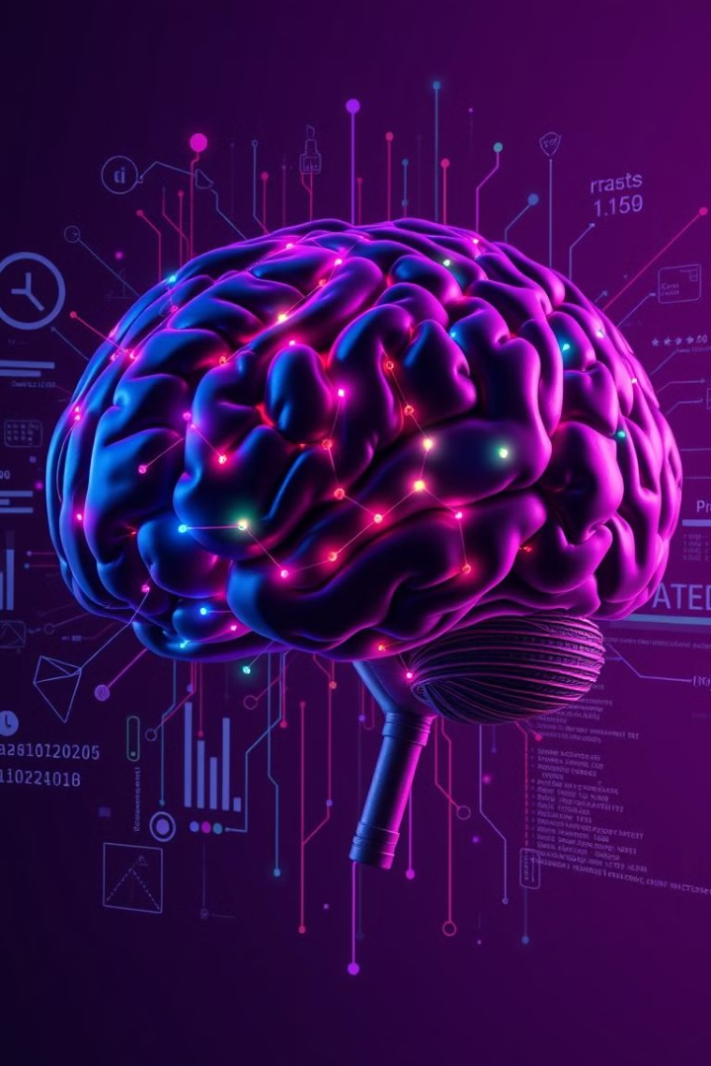

Machine Learning and Deep Learning: A Comprehensive Course
Welcome to this comprehensive course on Machine Learning and Deep Learning! This course aims to equip you with the essential knowledge and practical skills to navigate the exciting world of AI, from its foundational principles to cutting-edge applications.
by Pranit Pisal

Slide 2

What is Machine Learning?
Machine Learning (ML) is a branch of Artificial Intelligence (AI) that empowers computers to learn from data without explicit programming. It focuses on developing algorithms that can analyze data, identify patterns, and make predictions or decisions. Think of it as giving computers the ability to "learn" like humans do, but with vast amounts of data and incredible speed. ML is transforming industries by automating tasks, improving efficiency, and driving innovation. This course will provide you with a strong foundation in this transformative field.
1
Data-Driven Learning
2
Algorithmic Power
3
Real-World Impact
Machine Learning algorithms thrive on data. They learn from examples, and the more data they have, the better they become at performing their tasks.
The core of Machine Learning lies in its sophisticated algorithms designed to extract patterns and insights from data, enabling accurate predictions and decisions.
Machine Learning is revolutionizing various fields, from healthcare and finance to transportation and entertainment, impacting our daily lives in profound ways.

Slide 3
Supervised Learning Algorithms
In supervised learning, the algorithm is trained on labeled data, where each data point is paired with its corresponding output. This allows the algorithm to learn the relationship between inputs and outputs, enabling it to make predictions on new, unseen data. Think of it as having a teacher who provides correct answers, allowing the algorithm to learn the patterns and make accurate predictions in the future.
Regression
Classification
Regression algorithms predict continuous values, such as stock prices, house prices, or temperature. They aim to find a relationship between input variables and a continuous output variable.
Classification algorithms predict categorical values, such as classifying emails as spam or not spam, identifying images of cats or dogs, or diagnosing diseases based on patient data.

Slide 4

Unsupervised Learning Algorithms
Unsupervised learning focuses on discovering hidden patterns and structures in data without any labeled examples. In this scenario, the algorithm learns from unlabeled data, exploring relationships, clustering similar data points, and extracting insights without explicit guidance. This approach is powerful for tasks like anomaly detection, market segmentation, and dimensionality reduction. Imagine finding hidden connections in a vast dataset, unlocking new knowledge and understanding.
Clustering
Groups similar data points together, identifying distinct clusters within the data.
Association Rule Mining
Discovers relationships and dependencies between different items in a dataset, revealing interesting patterns.
Dimensionality Reduction
Simplifies data by reducing the number of variables, making it easier to analyze and visualize.

Slide 5
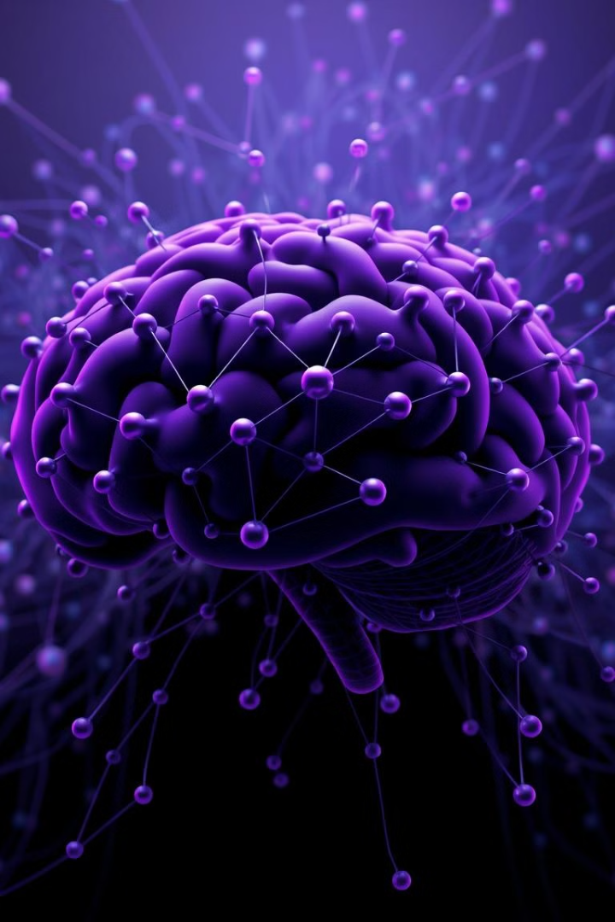



Neural Network Fundamentals
Neural Networks are powerful machine learning models inspired by the structure and function of the human brain. They are composed of interconnected nodes organized in layers, where each node performs a simple calculation. Data flows through these layers, being transformed and processed as it moves from input to output. The connections between nodes, known as "weights," are adjusted during training to optimize the network's ability to learn and perform specific tasks. These networks are remarkably flexible and adaptable, capable of solving complex problems in various domains.
Input Layer
The input layer receives the raw data, representing the features of the problem being solved.
Hidden Layers
Hidden layers perform computations on the input data, extracting complex patterns and features.
Output Layer
The output layer produces the final result, representing the model's prediction or classification.

Slide 6

Deep Learning Architectures
Deep Learning is a subfield of machine learning that utilizes deep neural networks, characterized by their numerous layers and interconnected nodes. These architectures are capable of learning highly complex patterns and features from large datasets. The depth of these networks enables them to handle challenging tasks that require sophisticated understanding and reasoning.
Feedforward Networks
Recurrent Networks
Information flows in a single direction, from input to output, without any feedback loops. These networks are well-suited for tasks like image classification and regression.
Recurrent Neural Networks (RNNs) have feedback loops, allowing them to process sequential data, such as text, speech, and time series. They excel in tasks like language modeling, machine translation, and sentiment analysis.
Convolutional Networks
Convolutional Neural Networks (CNNs) are designed for image and video processing. They use convolutional filters to extract features and patterns from the spatial structure of data, enabling tasks like object detection, image recognition, and image segmentation.

Slide 7




Convolutional Neural Networks
Convolutional Neural Networks (CNNs) are a specialized type of deep neural network designed for image and video processing. They use convolutional filters, which are small matrices that slide across the input image, extracting specific features, such as edges, textures, and shapes. These features are then processed through multiple layers, progressively extracting higher-level patterns and representations. CNNs have revolutionized image recognition, object detection, and video analysis, enabling applications like autonomous driving, medical imaging, and facial recognition.
Convolutional Filters
Extract features like edges, textures, and shapes from the image data.
Pooling Layers
Downsample the feature maps, reducing computational complexity and preserving essential information.
Fully Connected Layers
Combine the extracted features into a final output, classifying the image or performing other tasks.

Slide 8

Recurrent Neural Networks
Recurrent Neural Networks (RNNs) are designed for processing sequential data, such as text, speech, and time series. They incorporate feedback loops, allowing them to maintain a memory of previous inputs, making them suitable for tasks that involve understanding context and dependencies in sequential data. RNNs are widely used in language modeling, machine translation, speech recognition, and natural language processing.
1
Input Sequence
The RNN receives a sequence of inputs, one at a time, such as words in a sentence or time steps in a time series.
2
Hidden State
The RNN maintains a hidden state that stores information from previous inputs, allowing it to capture context and dependencies.
3
Output Sequence
The RNN produces an output sequence, predicting the next element in the sequence, such as the next word in a sentence or the next value in a time series.

Slide 9

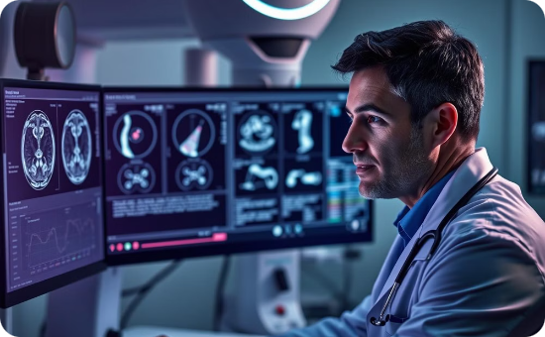

Practical Applications of ML and DL
Machine Learning and Deep Learning are transforming numerous industries and aspects of our lives. Their capabilities are vast, ranging from automating tasks to creating personalized experiences to solving complex scientific problems.
Autonomous Vehicles
Healthcare
E-commerce
Machine Learning algorithms power the perception, planning, and decision-making capabilities of self-driving cars, revolutionizing transportation and safety.
ML and DL are used for medical image analysis, disease prediction, drug discovery, and personalized medicine, improving patient care and outcomes.
Machine Learning is used for product recommendations, fraud detection, customer segmentation, and personalized shopping experiences, enhancing customer satisfaction and sales.

Slide 10

Course Conclusion and Resources
As we conclude this journey through the world of Machine Learning and Deep Learning, you are equipped with a strong foundation in the fundamentals of these transformative technologies. Remember that this is just the beginning of your exploration. The field of AI is constantly evolving, so staying curious and engaged with new developments is crucial.
1
Continue Learning
2
Practice & Experiment
Explore online courses, tutorials, and research papers to further expand your knowledge and stay updated on the latest advancements.
Implement your learning through hands-on projects, building your own Machine Learning models and exploring real-world applications.

